Slide 1
Programming in C

Slide 2
Week 9
Unit Testing

Slide 3

Warm-up

Slide 4
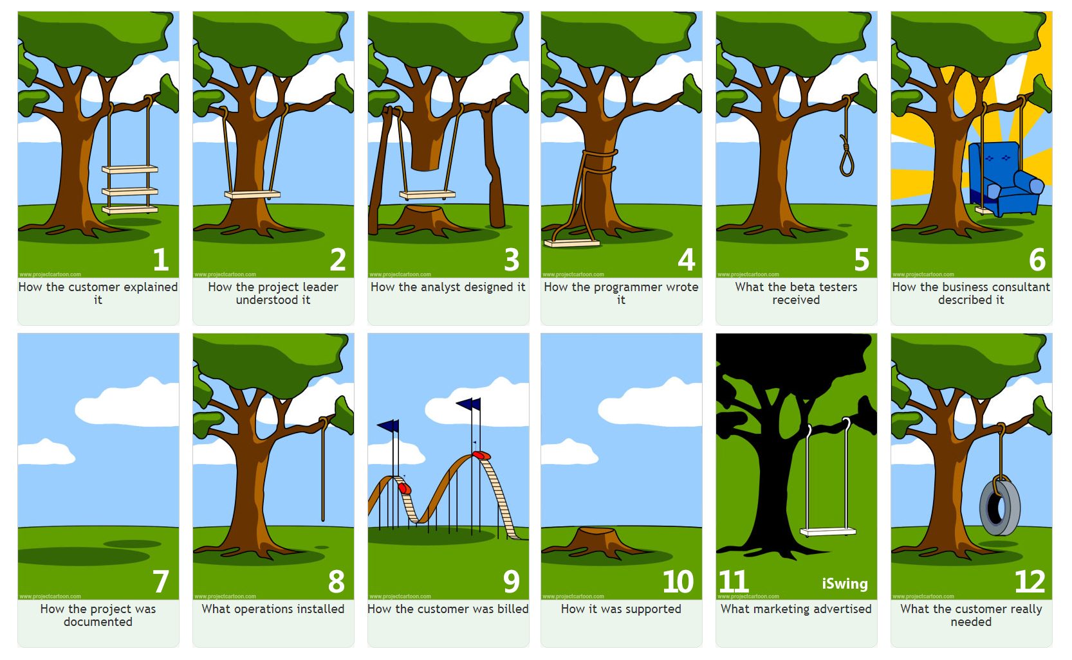
(Embedded) Software Testing
(Embedded) Software testing is a process to ensure that an (end)-user actually gets what he or she requested
What the user asked
What the user shouldn’t get
What the user should get

Slide 5
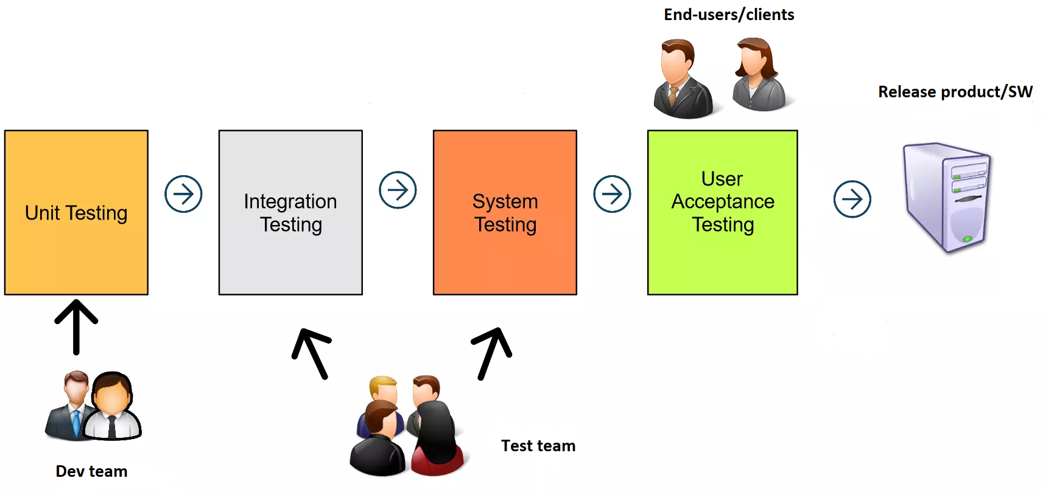
Levels in (Embedded) Software Testing

Slide 6
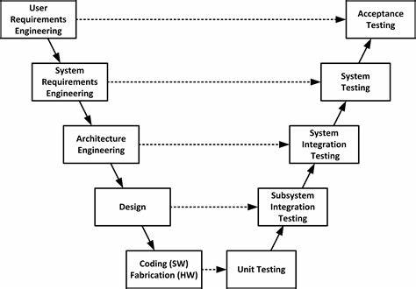
Levels in (Embedded) Software Testing

Slide 7
Levels in (Embedded) Software Testing
Scope of System/Acceptance test
Sensor
Micro-controller (e.g. esp32)
Actuator
Scope of integration test
UI
(e.g. WinForms)
What is the scope of unit tests?

Slide 8
Levels in (Embedded) Software Testing
Unit
Scope: 1 unit/component
Example: testing a function (e.g. in C) or a method (e.g. in C#)
Integration
Scope: (at least) 2 units/components
Example: testing communication between sensor and μC
System/Acceptance
Scope: all units/components
Example: testing user story or use case

Slide 9
Unit testing Frameworks
Examples of frameworks
Framework | Link(s)/Ressource(s)
Check | https://libcheck.github.io/check/
CTest | https://github.com/bvdberg/ctest
CUnit | https://cunit.sourceforge.net/
Cut | https://github.com/kube/cut
Unity | http://www.throwtheswitch.org/unity https://github.com/ThrowTheSwitch/Unity
We use Unity in T2-CB-PRC
Notes:
GoogleTest User’s Guide | GoogleTest

Slide 10
Installation of Unity framework
We will use the Unity framework in the PRC course
Access/download the installation guidelines from canvas
Install the Unity framework in your environment
Ask help from classmates/teachers when needed

Slide 11
How to define a test case
Assume that we want to test the following function: int find_maximum(a, b);
Examples of test cases:
ID | Description | Test inputs/conditions | Expected result
1 | Test function find_maximum when two inputs are positive | First input: 1 Second input: 2 | Function should return 2
2 | Test function find_maximum when two inputs are negative | First input: -1 Second input: -2 | Function should return -1
… | … | … | …

Slide 12
How to write a test case
Unit tests should follow the AAA Principle:
// ARRANGE : Define testing conditions (i.e. inputs of test and expected result(s) ) int a = 1;
int b = 2;
int expected_result = 2; // ACT : Execute/Call the function (i.e. unit) to be tested int actual_result = find_maximum(a, b); // ASSERT : Compare expected and actual results TEST_ASSERT_EQUAL_INT(expected_result, actual_result);
What is an assertion (aka assert) in SW?

Slide 13
Assertions supported by Unity framework
Examples of assertions. Be investigative and refer to the full list of assertions at:
http://www.throwtheswitch.org/unity
https://github.com/ThrowTheSwitch/Unity
Name | (Short) Description
TEST_ASSERT_EQUAL_INT | Asserts that two int variables are equal
TEST_ASSERT_EQUAL_UINT8 | Asserts that two uint8_t variables are equal
TEST_ASSERT_EQUAL_FLOAT | Asserts that two float variables are equal
TEST_ASSERT_EQUAL_INT_ARRAY | Asserts that two arrays of integers are identical
… | …

Slide 14

Demo of unity framework

Slide 15
Hints for defining (exhaustive) test cases
Check regular cases:
E.g. check that a function operates as expected if input parameters are set to value representing a regular/expected use of the function
Etc.
Check edge/corner cases:
E.g. check that a function still operates as expected if input parameters are set to either minimum or maximum value
Etc.
Check all possible execution path, in other words that all lines of code are tested
E.g. all if and else statements are tested in your function
Etc.
Check that your function does not manipulate NULL pointers
Do you see more possible test cases?

Slide 16
Hints for defining (exhaustive) test cases
It is the responsibility of the (embedded) software developer to define the needed test cases,
NOT the one of the end-user/client (or teacher) ;)

Slide 17
Exercises
Team-up with a classmate
Practice unit tests with the exercises provided in canvas (startUp_UnitTests.rar). Prior performing the exercises read the description (exercises_UnitTests.pdf) provided in the archive.
While performing the exercises, ask yourself the following:
What kind of test cases should we write?
How many test cases to write per function?
When do we know that a function is fully tested?

